Slide 1
DV1C04 Deployment and Monitoring in DevOps
L09
Patch Management

Slide 2
Learning Objectives
Explain the importance of patching
Describe types of patching
Describe DevOps role in patching
Implement patch management

Slide 3
Importance of Patching
Patch management can become a complex task thanks to the complexity of modern IT systems. Patching a system can require total system reboots, and the patching process can take anywhere from a handful of seconds to several hours for each computer on the network. Furthermore, patches aren’t always successfully deployed for various reasons. This has the potential to create a situation where mismanaged patching can result in service outages and massive amounts of downtime.
Leaving the job of patching up to each end user can result in mismanaged systems becoming potential security threats for the entire network. Due to the nature of patches, it’s not always possible to predict when a new patch may become available. Different software developers operate on different deployment schedules and an emergency security patch will generally be pushed out quickly to avoid catastrophic incidents. As such, proper patch management plays a key role in maintaining regular business operations without disruption.
Ref: https://www.bmc.com/blogs/patch-management/

Slide 4
Types of Patching
Binary patches.
Source code patches.
Large patches.
Hotfix.
Point release.
Program temporary fix.
Security patches.
Service pack.
Ref: https://en.wikipedia.org/wiki/Patch_(computing)

Slide 5
Challenges in Patching
There are quite a number of challenges in every patching cycle:
Time consuming
Error prone processes
Manual
Lack of visibility across entire site
Access control
Reporting/Sharing with stakeholders
https://www.youtube.com/watch?v=PEn5UZR0bso

Slide 6
Approach for Patch Management
Patch management requires careful planning, risk assessment, and attention to detail. A typical patch management system generally involves four steps: scanning, assessing, deploying, and monitoring:
Scanning – Checking devices for available patches.
Assessing – Analyzing the results of the scan to determine whether any patch need to be applied and prioritize them.
Deploying – Selecting the patches and applying the changes to the selected devices. This may involve staggering and scheduling of patches to reduce downtime and prevent experiencing interrupted services.
Monitoring – Monitor the entire process and ensuring that deployment is completed successfully.
Ref: https://www.bmc.com/blogs/patch-management/

Slide 7
Considerations in Patching
Patching operation can have multiple processes depending on the complexity of the patches and the expected impact may encounter.
Automation can be used to perform regular scanning operations and generate reports based on the findings. Patch downloading and the necessary resource checking and allocation required can be automated. Many aspects of patch management can be automated.
Ref: https://www.bmc.com/blogs/patch-management/

Slide 8
Considerations in Patching
One of the most important tasks of patch management is prioritizing system patches in order of importance while also balancing out the impact applying those patches will have on operations. Patching is often performed with staff involved
Many patches require downtime as systems may need to reboot to successfully apply the updates. Managing resources during this downtime can make the difference whether the operation is smooth or challenging.
Ref: https://www.bmc.com/blogs/patch-management/

Slide 9
Best Practices for Smooth Patching
The below shows some best practices which contributes to smooth patching activities.
Inventorize systems
Assign Risk Levels to systems
Consolidates Software and versions
Keep up With vendor patch releases
Mitigate patch exceptions
Test patches before applying to production
Apply application patches soonest possible
Automate open source patching
Ref: https://www.whitesourcesoftware.com/resources/blog/patch-management-best-practices/#Why_Is_Patch_Management_Important

Slide 10
Best Practices for Smooth Patching
Inventorize Systems
A comprehensive inventory of all software and hardware within your environment is a critical piece of any patch management process. These enable comparison of the known vulnerabilities to existing inventory to discover which patches need to be applied.
Assign Risk Levels To Systems
Risk levels helps to decide the right priorities in patching systems.
The more exposed to attack an item is, the faster it should be patched.
Ref: https://www.whitesourcesoftware.com/resources/blog/patch-management-best-practices/#Why_Is_Patch_Management_Important

Slide 11
Best Practices for Smooth Patching
Consolidate Software and Versions
The more versions of a piece of software you use, the higher the risk of exposure. . Decide on one version of Windows, Linux, or MacOs and keep that version up to date with patches.
When multiple pieces of software performing the same function, choose one and get rid of the rest. Fewer software products mean fewer patches need to be applied.
Ref: https://www.whitesourcesoftware.com/resources/blog/patch-management-best-practices/#Why_Is_Patch_Management_Important

Slide 12
Best Practices for Smooth Patching
Keep Up With Vendor Patch Announcements
Third-party vendors products are commonly use to perform tasks.
Keeping up with vendor patch announcements is key in heterogeneous environment. Create a process to ensure each patch can be added to the patch schedule.
Mitigate Patch Exceptions
Sometimes a patch cannot be applied right away. Changes may be needed to make the patch work. This will take time. Do not leave an unpatched server exposed to the Internet. Figure out how to reduce the impact and likelihood of an exploit until the patch can be applied safely.
Ref: https://www.whitesourcesoftware.com/resources/blog/patch-management-best-practices/#Why_Is_Patch_Management_Important

Slide 13
Best Practices for Smooth Patching
Test Patches Before Applying to Production
A patch could cause problems or even bring down machines with certain configurations. A patch are usually applied to development or test environment to make sure there are no major problems. Patching as soon as possible does not mean applying the patch straight to production. A plan should be in place to get everything patched in a timely manner.
Automate Open Source Patching
Open source components help dev teams to build software more efficiently. But open source libraries are susceptible to the same vulnerabilities as other software.
Ref: https://www.whitesourcesoftware.com/resources/blog/patch-management-best-practices/#Why_Is_Patch_Management_Important

Slide 14
DevOps in Patching
Integrate patch development and deployment via a CI/CD pipeline can significantly reduce the time to fix and distribute software patches and security patches, while reducing much of the administrative overhead of patch management.
When a bug is reported, a patch can be developed and deployed via Jenkins pipeline.

Slide 15
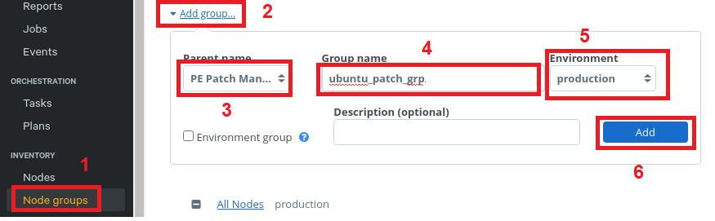
Puppet Patch Management
1. In the PE console, select Node groups -> Add group.
2-6. Specify options for the new node group, then select Add.
Parent name -> PE Patch Management.
Group name – Enter a meaningful name -> ubuntu_patch_grp.
Environment -> production.
Environment group – Do not select.

Slide 16
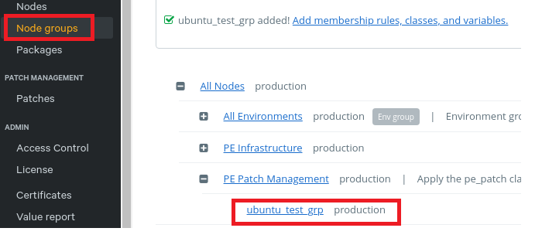
Puppet Patch Management
7. Select the patching node group that is just created -> ubuntu_patch_grp

Slide 17
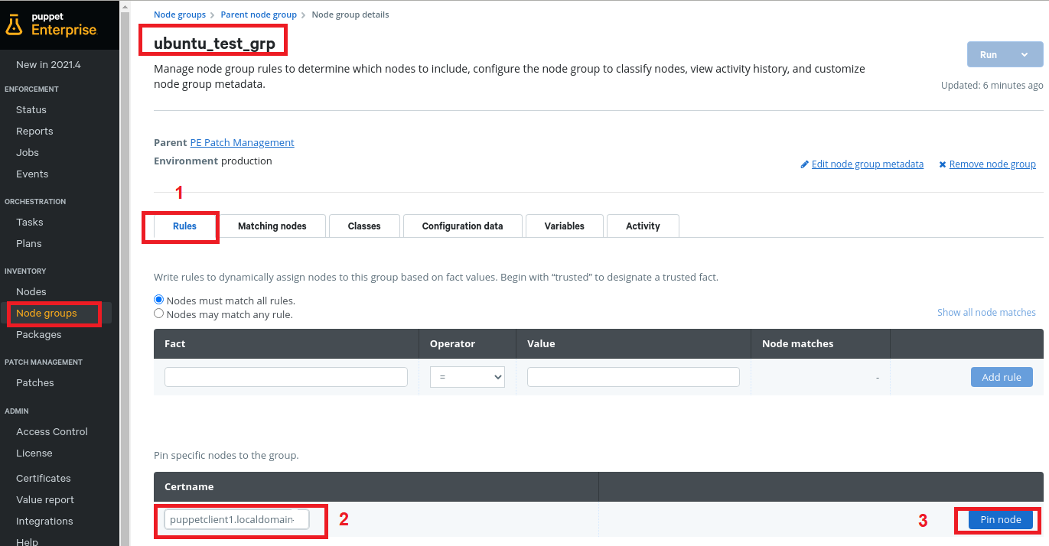
Puppet Patch Management
8. On the Node group details -> Rules tab -> add nodes to the group (pin them individually).

Slide 18
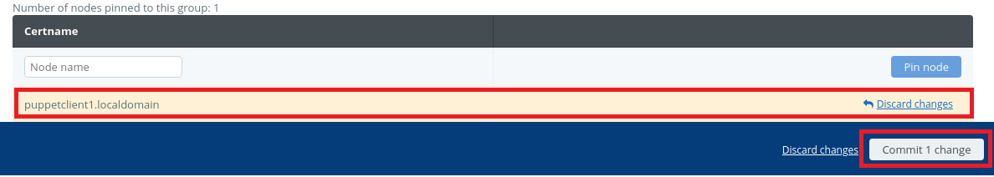
Puppet Patch Management
9. Click on Pin node after the node is selected. Then click on Commit 1 change

Slide 19
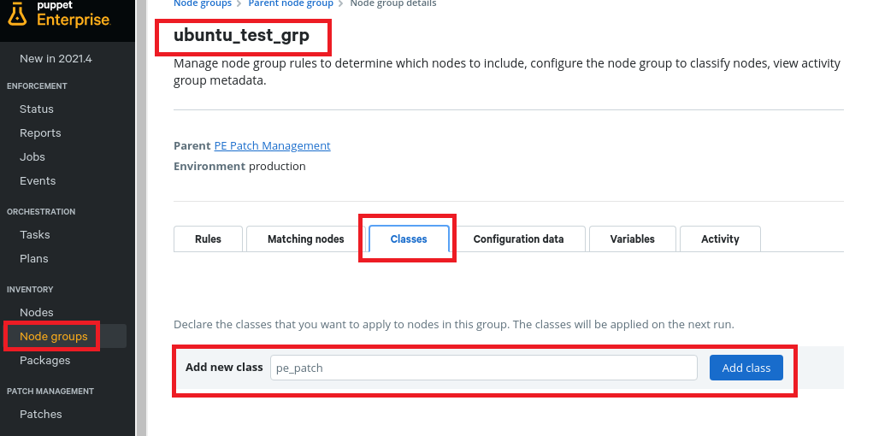
PE_PATCH Class
Set parameters for node group ubuntu_patch_grp under patch management by first applying the pe_patch class to them, then specifying the desired parameters.

Slide 20
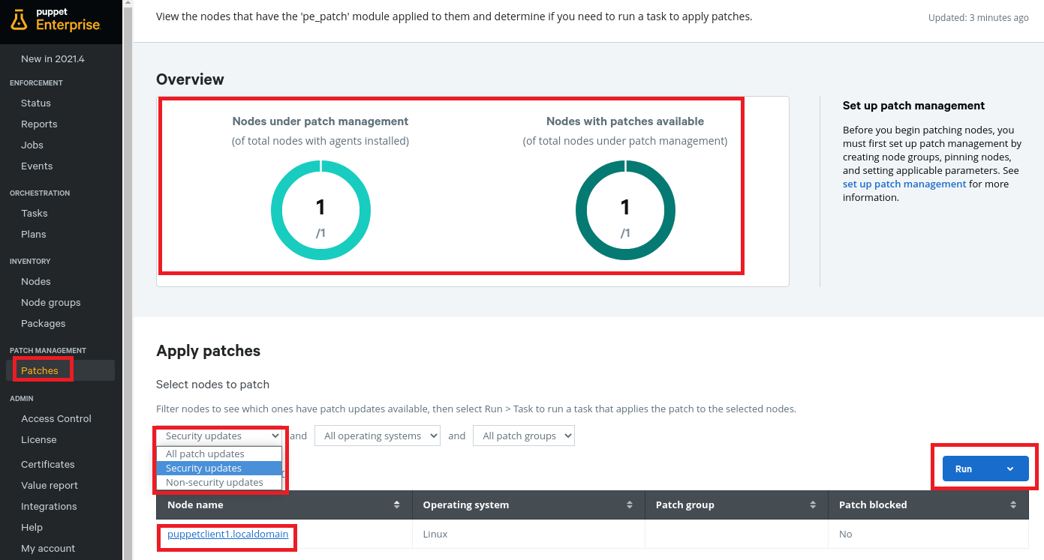
Apply Patches to Nodes
On the Patches page, in the Apply patches section, use the filters to specify which patches to apply to which nodes.

Slide 21
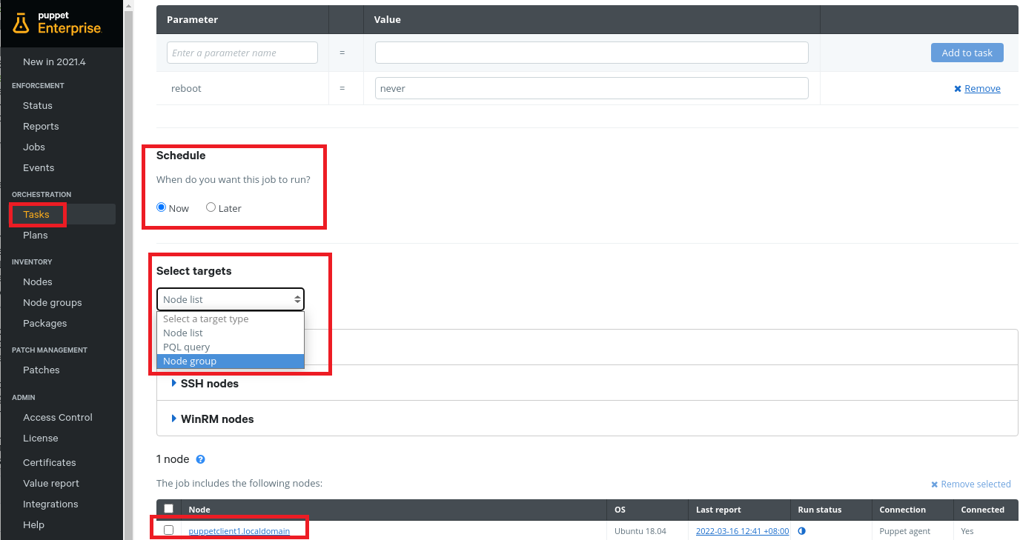
Apply Patches to Nodes (Cont’)
Select Run -> Task to apply patches.

Slide 22
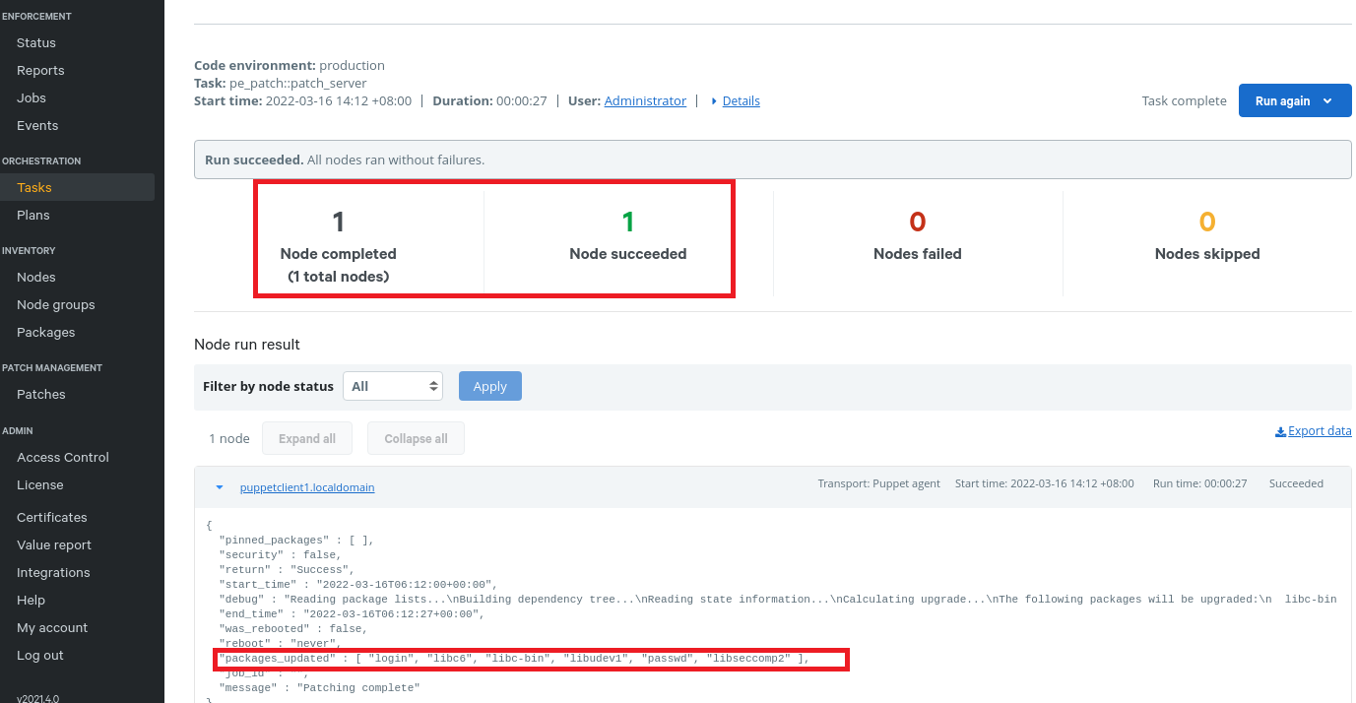
Apply Patches to Nodes (Cont’)
The following screen shows successfully apply patches to a node, which is in the node group for patching.

Slide 23
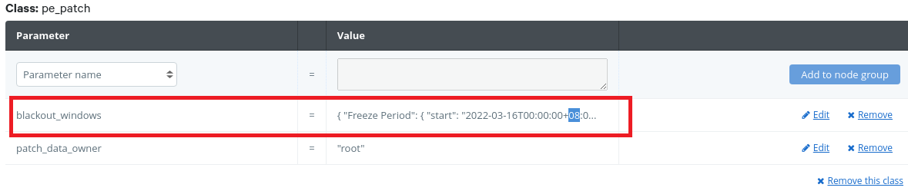
Blackout Windows
Blackout windows can be configured so that patching cannot be performed during these period. The blackout windows is configured under the parameter Blackout_Windows under pe_patch class (as shown below)

Slide 24
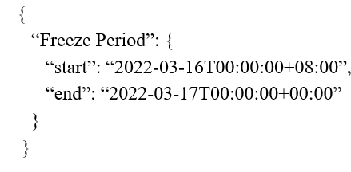
Blackout Windows
For example, set a blackout window from 16 March 2022 SGT 00:00 to 17 March 2022 SGT 00:00 looks like this:

Slide 25
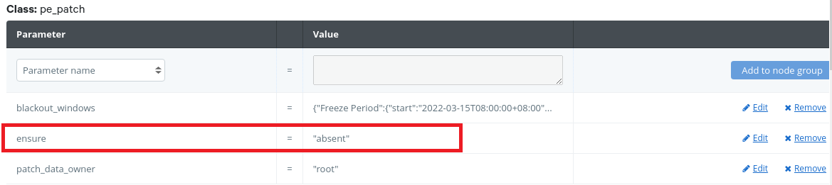
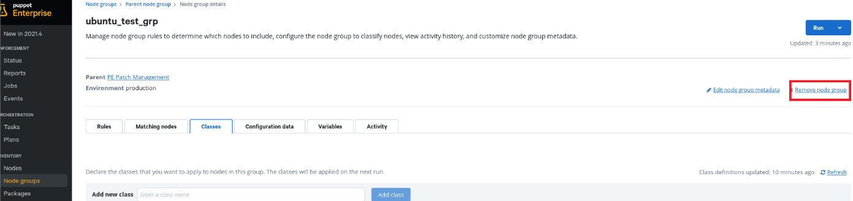
Disable Patch Management
There are 2 ways to disable patch management:
Use the console to disable patch management by editing the ensure parameter in the PE Patch Management node group.
Remove patch management by deleting patching node groups.

Slide 26
References
https://en.wikipedia.org/wiki/Patch_(computing)
https://www.bmc.com/blogs/patch-management
https://www.whitesourcesoftware.com/resources/blog/patch-management-best-practices/#Why_Is_Patch_Management_Important
https://puppet.com/docs/pe/2021.1/patch_management_setup.html#patch_management_setup

Slide 27
Thank you

